Slide 1
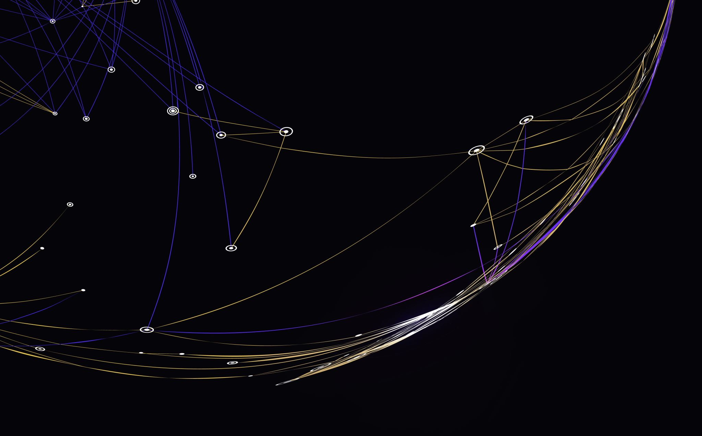
Functions
Clean Code – Chapter 3

Slide 2
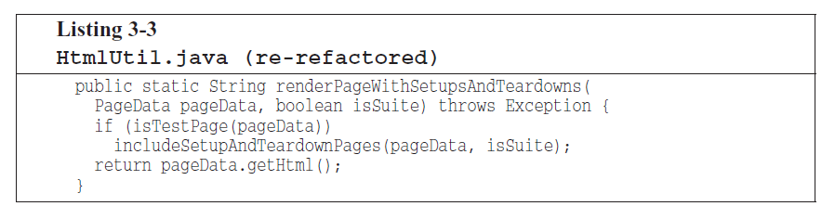
Small!
The first rule of functions is that they should be small.
The second rule of functions is that that they should be smaller than that.
How short should a function be?
Example:

Slide 3
Small! – Blocks and Indenting
Blocks within if statements, else statements, while statements, and so on should be one line long.
This keeps the enclosing function small, this also adds documentary value because the function called within the block can have a nicely descriptive name.
Probably that line should be a function call.

Slide 4
Do One Thing
“FUNCTIONS SHOULD DO ONE THING. THEY SHOULD DO IT WELL. THEY SHOULD DO IT ONLY.”
If the function does only those steps that are one level below the stated name of the function, then the function is doing one thing.
Another way to know that a function is doing more than “one thing” is if you can extract another function from it with a name that is not merely a restatement of its simple implementation.

Slide 5
One Level of Abstraction per Function
Mixing level of abstraction within a function is always confusing.
Readers may not be able to tell whether a particular expression is an essential concept or detail.
High level: sendEmail() – describe what we want to do.
Medium level: formatEmailBody(template, date) – describe how we organize the work.
Low level: string.append(“\n”) – describes specific implementation details.

Slide 6
One Level of Abstraction per Function – Reading Code from Top to Bottom: The Stepdown Rule
The stepdown rule:
Organize your code so it reads like a story from top to bottom, with each function leading naturally to the next.
Instead of jumping between high-level concepts and low-level details randomly, your code flows smoothly from general to specific as you read down the page.

Slide 7
Switch Statements
It’s hard to make a small switch statement.
To solve this, we should make sure that each switch statement is buried in a low-level class and is never repeated.
We do this with “polymorphism”.
A general rule for switch statement is that they can be tolerated if they appear only once, are used to create polymorphic objects, and are hidden behind an inheritance relationship, so that the rest of the system can’t see them.

Slide 8
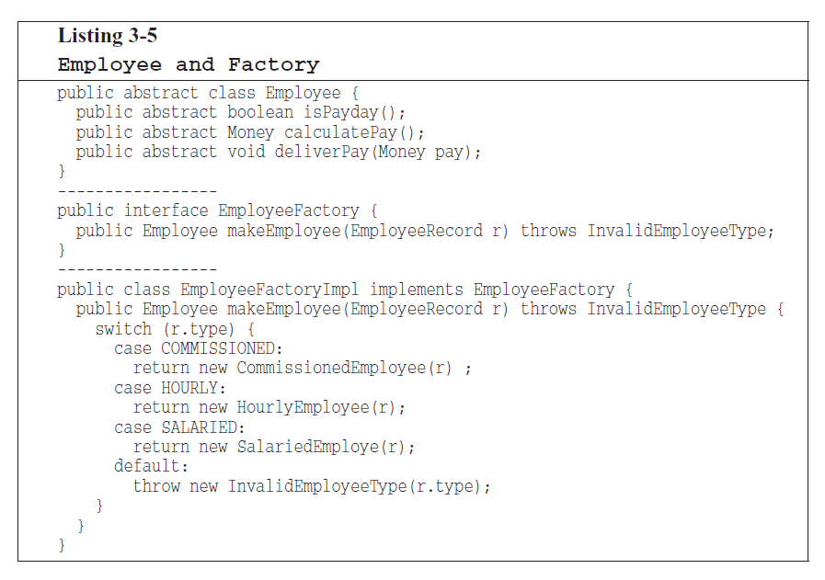
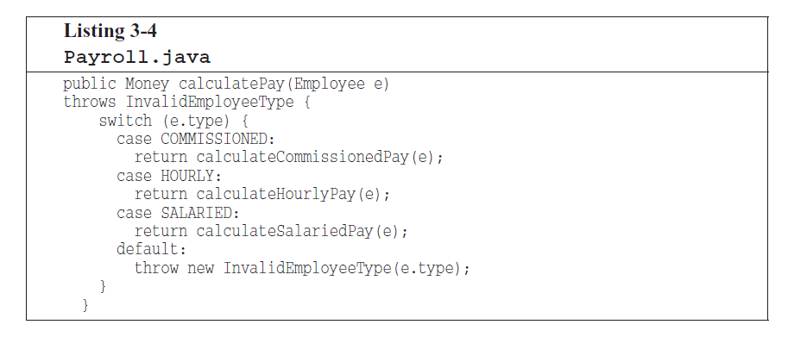
Switch Statements (cont.)

Slide 9
Use Descriptive Names
“You know you are working on clean code when each routine turns out to be pretty much what you expected.”
To achieve that principle choose good names for small functions that do one thing.
The smaller and more focused a function is, the easier it is to choose a descriptive name.
A long descriptive name is better than a short enigmatic name.

Slide 10
Use Descriptive Names (cont.)
Don’t be afraid to spend time choosing a name. Indeed, you should try several names and read the code with each in place.
Choosing descriptive names will clarify the design of the module in your mind and help you to improve it.
Be consistent in your names. Use the same phrases, nouns, and verbs in the function names you choose for your modules.

Slide 11
Function Arguments
The ideal no. arguments for a function is zero (niladic), next comes one (monadic), followed closely by two (dyadic).
Three arguments (triadic) should be avoided where possible.
More than three (polyadic) requires very special justification-and then shouldn’t be used anyway.

Slide 12
Function Arguments – Common Monadic Forms
When a function takes one argument, it usually does one of three things:
Ask a question: like checking if a file exists `(boolean fileExists(“myFile”))`.
Transform the input: like turning a file name into a stream `(InputStream fileOpen(“myFile”))`.
Act as an event: like logging a failed password attempt `(void passwordAttemptFailedNtimes(int attempts))`.
If you’re transforming something, return the result – don’t just modify the input.

Slide 13
Function Arguments – Flag Arguments
Flag arguments are ugly.
Passing a boolean into a function id a truly terrible practice.

Slide 14
Function Arguments – Dyadic Functions
A function with two arguments id harder to understand than a monadic function.
There are times, where two arguments are appropriate.
`Point p = new Point(0, 0);`
The two arguments in this case are ordered components of a single value.
Dyads aren’t evil, and you will certainly have to write them.
However, you should be aware that they come at a cost and should take advantage of what the mechanism may be available to you to convert them into monads.

Slide 15
Function Arguments – Triads
Functions with three arguments are significantly harder to understand than dyads.
The issues of ordering, pausing, and ignoring are more than doubled.

Slide 16
Function Arguments – Argument Objects
When a functions seems to need more than two or three arguments, it’s likely that same of those arguments ought to be wrapped into a class of their own.
Reducing the no. arguments by creating objects out of them may seem like cheating, but it’s not.
Circle makeCircle(double x, double y, double radius);
Circle makeCircle(Point center, double radius);

Slide 17
Function Arguments – Argument Lists
Sometimes, we need to pass a variable no. arguments into a function.
String.format(“%s worked %.2f hours”, name, hours);
If the variable arguments are treated identically, then they are equivalent to a single argument of type List.
String.format is actually dyadic.
Functions that take variable arguments can be monads, dyads, or even triads.
But it would be a mistake to give them more arguments than that.

Slide 18
Function Arguments – Verbs and Keywords
Choosing a good name for a function can go a long way toward explaining the intent of the function and the order and intent of the arguments.
`writeField(name)` is better than `write(name)`, as it tells us that the “name” thing is a “field”.
Using this form we encode the names of the arguments into the function name.

Slide 19
Has No Side Effects
Side effects are lies.
Your function promises to do one thing, but it also does other hidden things.
Makes unexpected changes to the variables of its own class.
Makes them to the parameters passed into the function or to system globals.

Slide 20
Has No Side Effects – Output Arguments
Arguments are most naturally interpreted as inputs to a function.
`appendFooter(s);`
Does this function append s as the footer to something? OR
Does it append some footer to s?
This forces us to check the function’s full definition.
`report.appendFooter();`
Nowadays, in OOP, it’s clear to let the object change itself.

Slide 21
Command Query Separation
Functions should either do something or answer something, bit not both.
Mixing the two causes confusion.
`if (set(“username”, “unclebob”)) …`
It’s unclear:
Does it set the value?
Or is it just checking if the values was already set?

Slide 22
Command Query Separation (cont.)
`if (attributeExists(“username”)) {
setAttribute(“username”, “unclebob”);
}`
This way:
One function checks something.
The other performs the action.
No confusion for the reader.

Slide 23
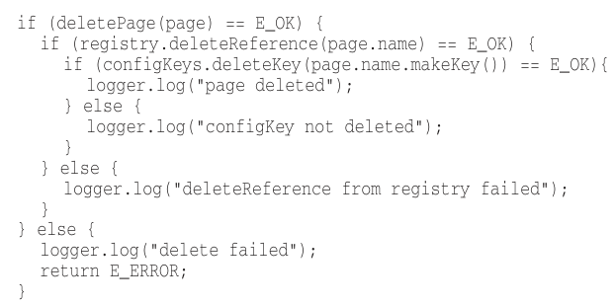
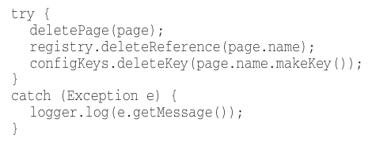
Prefer Exceptions to Returning Error Codes
Returning error codes from command functions is a subtle violation of CQS.
Returning errors Exceptions

Slide 24
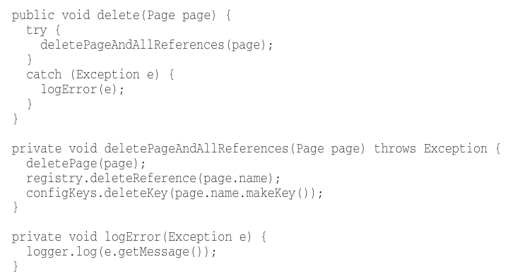
Prefer Exceptions to Returning Error Codes – Extract Try/Catch Blocks
Try/catch blocks are ugly in their own right.
The confuse the structure of the code and mix error processing with normal processing.
So, it’s better to extract the bodies of the try and catch blocks out into functions of their own.

Slide 25
Prefer Exceptions to Returning Error Codes – Error Handling Is One Thing
Functions should do one thing.
Error handling is one thing.
Thus, a function that handles errors should do nothing else.
This implies that if the keyword try exists in a function:
It should be the very first word in the function.
And that there should be nothing after the catch/finally blocks.

Slide 26
Prefer Exceptions to Returning Error Codes – The Error.java Dependency Magnet
Returning error codes usually implies that there’s some class or enum in which all the error codes are defined.
public enum Error {
OK,
INVALID,
NO_SUCH,
LOCKED,
OUT_OF_RESOURCES,
WAITING_FOR_EVENT
}

Slide 27
Prefer Exceptions to Returning Error Codes – The Error.java Dependency Magnet (cont.)
Classes like this are a dependency magnet; many other classes must import and use them.
Thus, when the Error enum changes, all those other classes need to be recompiled and redeployed.
This puts a negative pressure on the Error class.
Programmers don’t want to add new errors because then they must build and redeploy everything.
So, they reuse the old error codes instead of adding new ones.

Slide 28
Prefer Exceptions to Returning Error Codes – The Error.java Dependency Magnet (cont.)
When we use exceptions, new exceptions are derivatives of the exception class.
They can be added without forcing any recompilation or redeployment.

Slide 29
Don’t Repeat Yourself
Duplication may be the root of all evil in software.
Structured programming, Aspect Oriented Programming, Component Oriented Programming, are all, in part, strategies for eliminating duplication.
Innovations in software development have been an ongoing attempt to eliminate duplication from our source code.

Slide 30
Structured Programming
Edsger Dijkstra said:
Every function, and every block within a function, should have one entry and one exit.
Following this rule means that there should only be one return statement in a function, no break or continue statements in a loop, and never, ever, any goto statement.
These rules provide significant benefit only in large functions.

Slide 31
How Do You Write Functions Like This?
Writing software is a lot like writing articles, the first draft is often messy and needs refining.
Initial code tends to be long, complex, and disorganized, but unit tests ensure it works.
Through continuous refactoring “splitting out functions, changing names, eliminating duplication”, the code becomes clean, structured, and maintainable.

Slide 32
Conclusion
Every system is built using a domain-specific language created by its programmers, where functions act as verbs and classes as nouns.
Master programmers treat systems as stories, designing expressive languages within their code to clearly communicate that story.
Writing good functions isn’t just about structure and naming – it’s about crafting a coherent language that tells the system story clearly.

